Slide 1

Husky Space Monitor
- Zhiyi Wang
An iOS app for Northeastern student to monitor class space

Slide 2
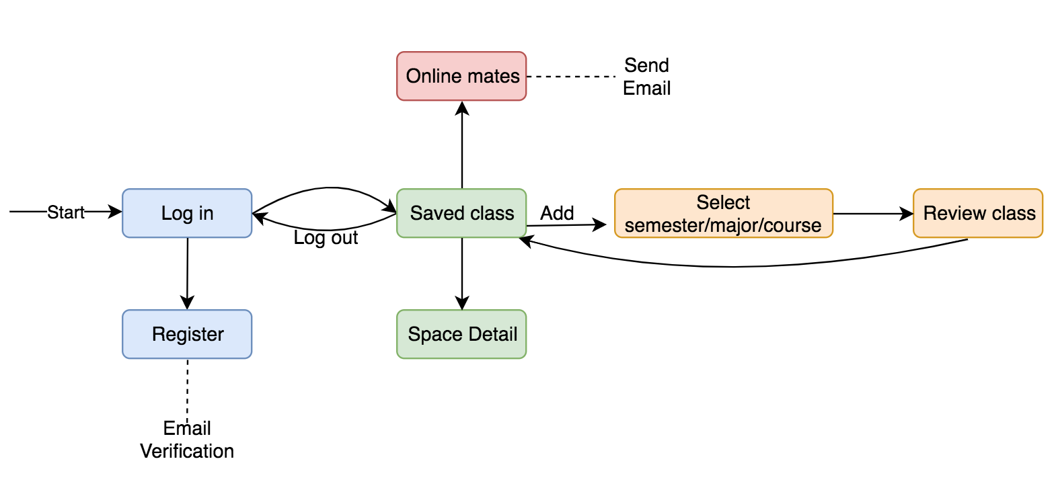
App Overview - Workflow

Slide 3
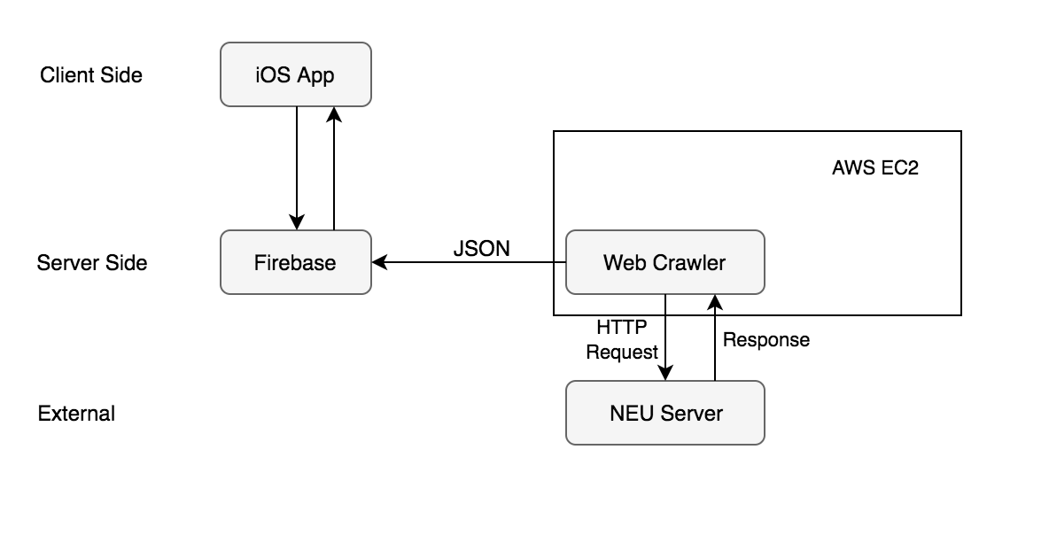
App Overview - Structure

Slide 4
App Overview – Technologies
App Core
Web Crawler
Testing

Slide 5
DEMO
iOS:
Register & Email Verification
Login
Add Class / Delete Class
Online mates & send email
Firebase
Web Crawler by Apify
JSON export
Time to play

Slide 6
Future Plan
Time line
Action
Day 1 – 3
Day 4 – 7
Day 8 – 12
Day 13 – 15
Day 16 – 20
Day 21 – 25
Day 26 - 29
Facebook, Google, GitHub Login
Web Crawler for all classes
Online Mates Instant Chat + Push Notification
App Store Release - Version 0.5
Crawler Automation as RESTful API
Deploy automated Crawler API to AWS
App Final Trim & Better UI – Version 1.0

Slide 7
Thank you
I hope you will enjoy my App
☺

